Slide 1
Lending Club Case Study
Shah Yousuf Quadri​

Slide 2
AGENDA
Introduction​
Data Understanding
​Data Cleanup
Data Analysis
​Summary​

Slide 3
Introduction
In this case study, you will use EDA to understand how consumer attributes and loan attributes influence the tendency of default.
When a person applies for a loan, there are two types of decisions that could be taken by the company:
Loan accepted: If the company approves the loan, there are 3 possible scenarios described below:
Fully paid: Applicant has fully paid the loan (the principal and the interest rate)
Current: Applicant is in the process of paying the instalments, i.e. the tenure of the loan is not yet completed. These candidates are not labelled as 'defaulted'.
Charged-off: Applicant has not paid the instalments in due time for a long period of time, i.e. he/she has defaulted on the loan
Loan rejected: The company had rejected the loan (because the candidate does not meet their requirements etc.). Since the loan was rejected, there is no transactional history of those applicants with the company and so this data is not available with the company (and thus in this dataset)

Slide 4
Data Understanding
Business Objectives
This company is the largest online loan marketplace, facilitating personal loans, business loans, and financing of medical procedures. Borrowers can easily access lower interest rate loans through a fast online interface.
Types of variables
• Customer (applicant) demographic
• Loan related information & characteristics
• Customer behavior (if the loan is granted)
Customer data
member_id
emp_length(Experience)
annual_inc(annual income)
Loan Related info
Loan_amount
Loan_intrest
Loan_status
Customer Behavious
Application type
Loan purpose
Recoveries

Slide 5
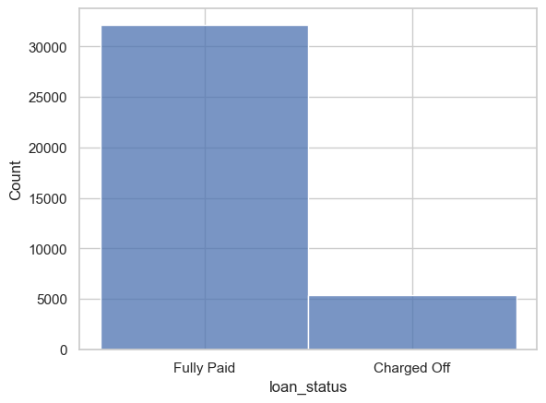
Univariate analysis
With univariate analysis we see that approx.
14% loan borrower defaulted (charged off) there loan.

Slide 6
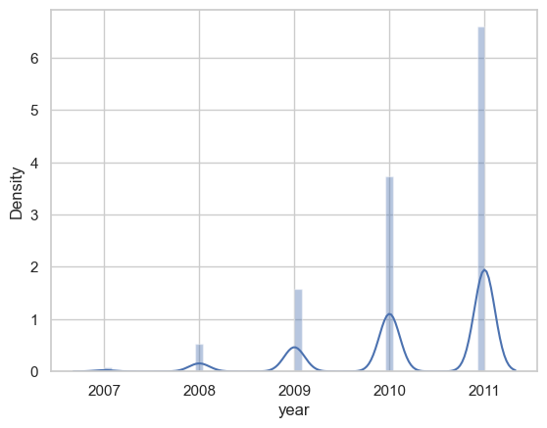
Univariate analysis
Univariate analysis also tells us that there is
a huge increase in loan applicants over the years
From 2007 to 2011

Slide 7
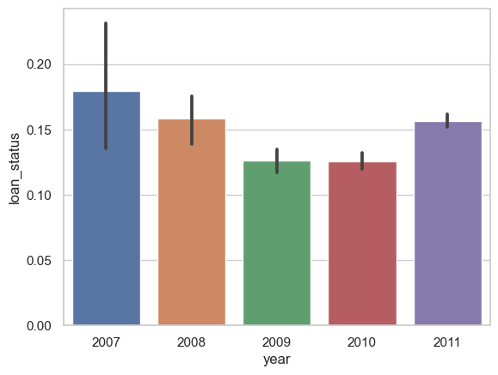
Bivariate analysis
If we check the loan defaulters against for each year we have this following bivariate plot which states that
After 2008 there is an increase in defaulters.

Slide 8
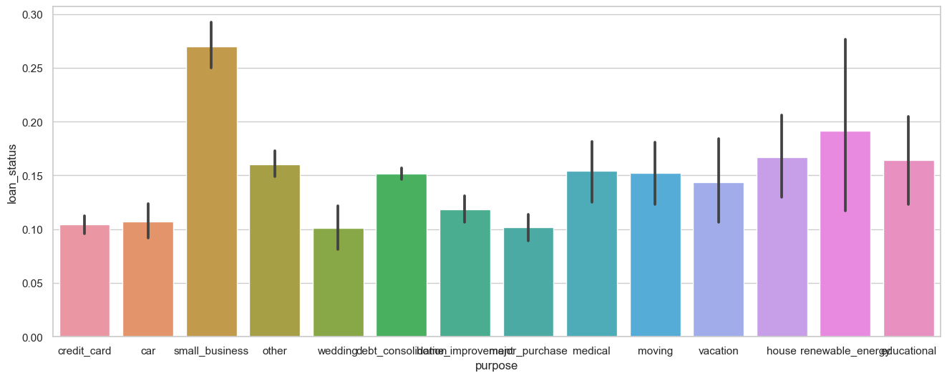
Bivariate Analysis
Applicants with loan purpose as small business are likely to default as per the data set given so approving the loan for small business applicants is more risky.

Slide 9
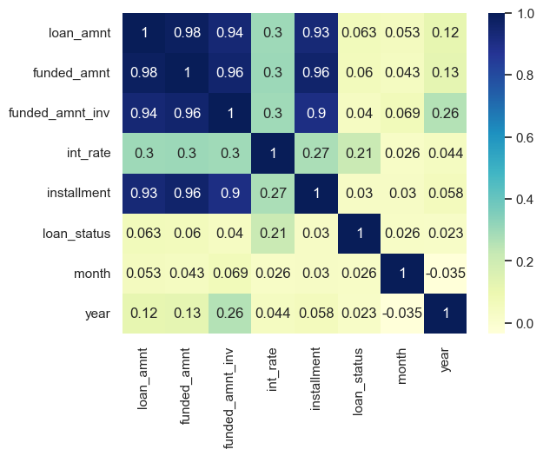
Multivariate analysis
During multivariate analysis we have found that interest rate and loan status are tightly corelated when interest rate increases rate of defaulters also increase.

Slide 10
SUMMARY
Approximately 14% applicants are defaulters in data provided.
There is a huge increase in applicants for loan during the period
Application with purpose as ‘Small business’ are likely to Charged-off the loan.
Interest rate and defaulters ratio are tightly correlated if interest rate increases the defaulters ratio also increases.

Slide 11
THANK YOU
Shah Yousuf Quadri​
Quadri.yousuf8@gmail.com

